Slide 1
Global Project Assessment Model
ROAD MAINTENANCE Abidjan Project – 25 Sept, 2024

Slide 2
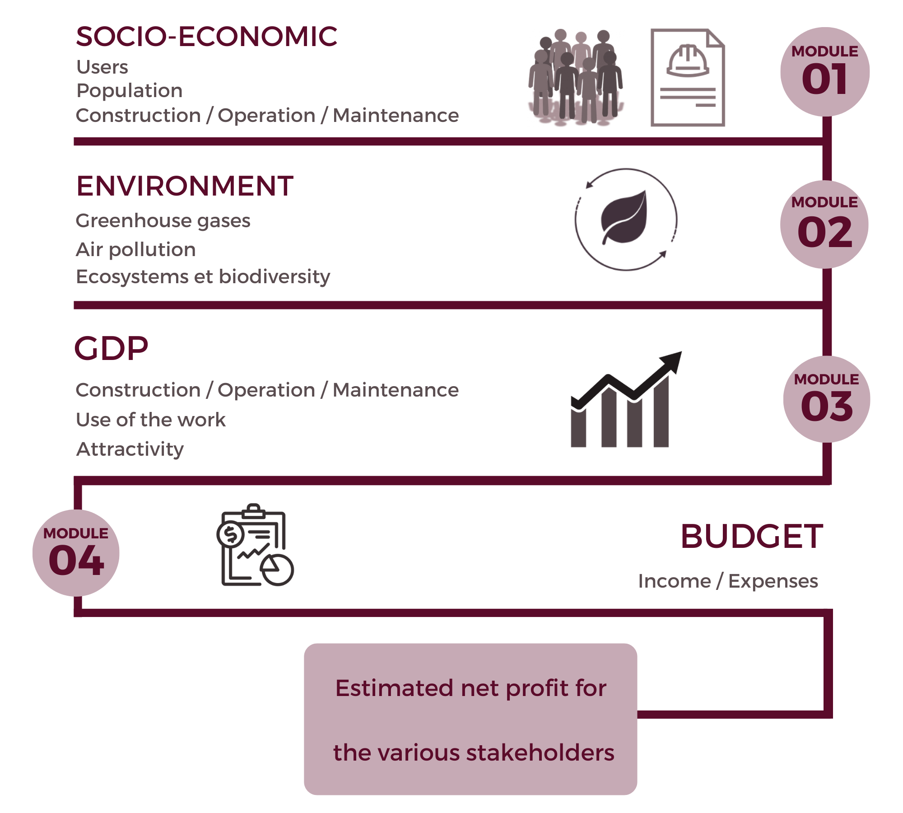
WHAT IS THE GLOPRAM© ? GLOBAL PROJECT ASSESSMENT MODEL

Slide 3
WHAT IS THE GLOPRAM© ? GLOBAL PROJECT ASSESSMENT MODEL
A decision support tool which allows to:
evaluate budgetary impact of a project (yearly cash flows from and for Finance Ministry)
select the most efficient contractual mode
It completes the conventional cost-benefit analysis by introducing a WORK ANALYSIS MODULE, a GDP MODULE and a BUDGET MODULE that enable a predictive estimate of the impact of the project on the GDP and the budget of the various stakeholders
The long-term funding of transport network maintenance in Abidjan will would be easier to determine using the GLOPRAM

Slide 4
New project : New motorway. Cost = 180 Millions. 15 000 v/day Budgetary balance for all contracts is largely positive. Concession is the most efficient

Slide 5
Same as before, but discounted at 4%/year. Govt paid PPPs becomes more efficient that traditional procurement with this discount rate

Slide 6
HOW WOULD THE GLOPRAM© BENEFIT THE MAINTENANCE PROJECT?
Maintenance cost is an insurance premium against loss of productivity. It directly affects the GDP by maintaining the production factors at their best.
Comparison between minimal and optimal maintenance and Identification of additional revenue for the State
Estimation of the net benefit for users and the population that allows a feasibility analysis of the implementation of a specific toll and/or tax
Sensitivity analysis of the net profit for the different stakeholders to the various tariffs under consideration

Slide 7
MAINTENANCE METHODOLOGY : COMPARISON of 2 SCENARIOS
Work period : detailed budgetary impact
Operation period: benefits evaluation, then additional GDP and additional taxes
By type of works, cost estimation for :
Salaries
Local and foreign
Equipment
Local and foreign
Energy
Local and foreign
Additional consumption due to works
Split formal/informal activities and evaluation of related taxes and duties
For Transports
Time saved, vehicle operation cost saved, improvement for health, safety and environment
For Energy
Cost reduction, availability and all related consequences, like reduced risk of production loss in factories…
For Education
Avoiding loss of teaching quality and of student number
For Health
Avoiding loss of treatment quality and patient number

Slide 8
MAINTENANCE ROAD METHODOLOGY
1_Description of the present network and traffic flows
2_Traffic forecasts for HGV, busses and cars
3_Evolution of network service level according to year, traffic level and maintenance level
4_Estimation of the true budgetary cost of maintenance, incl. fiscal analysis according to the type of works
5_Evaluation network quality (IRI and Potholes evolution) according to maintenance
6_Speed evolution on the network, thus total travel time spent and vehicle use costs
7_Evolution of accessibility to jobs and shopping
8_Estimation of GDP increase due to accessibility increase (formal jobs only for salary taxes, consumption for all additional revenues)
9_Estimation of fiscal additional revenues due to GDP increase

Slide 9
Structure of the
GLOPRAM
Environment
GDP
Socio-economic
Budget
Appraisal of additional revenues
Additional costs/benefits
Cars → time saving
Cab → increased productivity
Trucks → time saving+cost reduction
Firms → positive externalities
Suggested tax on these additional revenues
Appropriate pricing
Appropriate additional tax
Budget balance for cars, cabs and trucks
Budget balance for the State
Budget balance for a collecting agency such as " FER "
Budget balance for the Autonomous District of ABIDJAN

Slide 10
GLOPRAM completes the existing tools
HDM-4
L²R Programme
Results
EMME4
Results
Social typology
Country tax laws and regulations
Biodiversity and ecosystems
Country financial informations
Additional GDP
Additional tax revenue
Pricing proposal

Slide 11
Utilization of data produced by EMME4, HDM-4, L²R and GLOPRAM
EMME 4
L²R prog.
Traffic forecasts
HGV, Personal cars, G’bakas, taxis
Time lost due to congestion
Economic costs borne by users (operation and time)
Economic costs for road operation and maintenance
Social impact (noise, pollution)
CONGESTION COST &
OPERATION COSTS
CONVERSION TO MONETARY VALUES
Cost Benefit Analysis and GDP evaluation
Estimated impact on GDP
Toll acceptability and potential commercial revenues
Net benefit for the users and the population (time saving, safety gain...)
Environmental assessment
Additional tax revenues

Slide 12
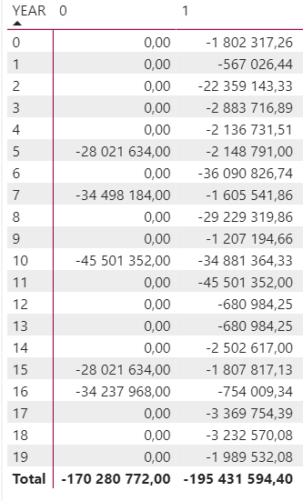
WORK PROGRAMME BY SCENARIO
(HDM 4 OUTPUTS for 2 scenarios)
Additional cost of scenario 1 compared to scenario 0
25 150 822

Slide 13
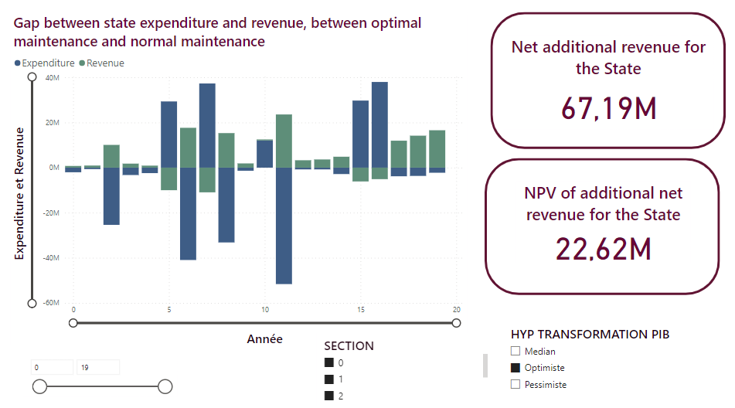
RESULT: BUDGETARY SAVINGS EVALUATION
Additional cost of scenario 1 compared to scenario 0
25,15 M

Slide 14
Thank you for your attention

